Slide 1


HOME AUTOMATION USING VOICE COMMAND BASED ON IOT
PREPARED BY :
18DCS052 – VARADA R NAIR
18DCS045 – RUTIKA MEHTA
18DCS053 – MANSI NAKRANI

Slide 2
OUT LINE
Abstract
Objective
Motivation
Hardware Requirements
Software Requirements
Block Diagram
Implementation screenshots
Roles and responsibilities of every project member
Expected Outcome
Future scope
References

Slide 3
ABSTRACT
The main objective of this project is to develop a home automation system using ESP8266 NODE MCU – Wi-Fi Module with Google Assistant and other third party applications being remotely controlled by any Android smart phone. Since modern houses are gradually shifting from conventional switches to centralized control system, our project aims at developing one such mini Home Automation System wherein nearby appliances can be controlled remotely.

Slide 4
OBJECTIVE
The objective of this project was to implement and explore the already known concept of using Arduino and IoT and also to learn to manage different kinds of errors.
Idea of creating an inexpensive time saving and energy efficient project motivated us to switch to IoT Home Automation using Google Assistant.

Slide 5
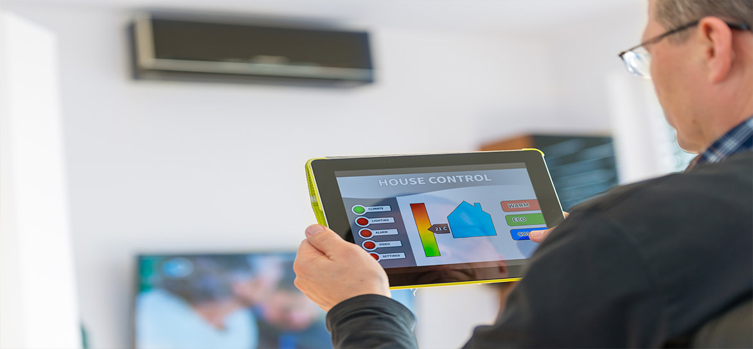

MOTIVATION
Low Cost System
Reliable System
Efficient System
System which can be accessed
by people of all age groups

Slide 6
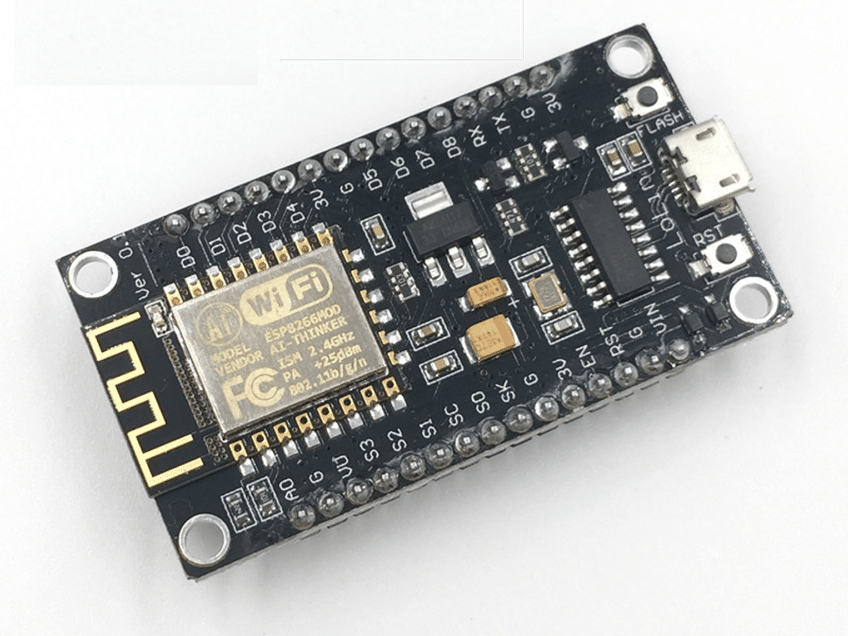
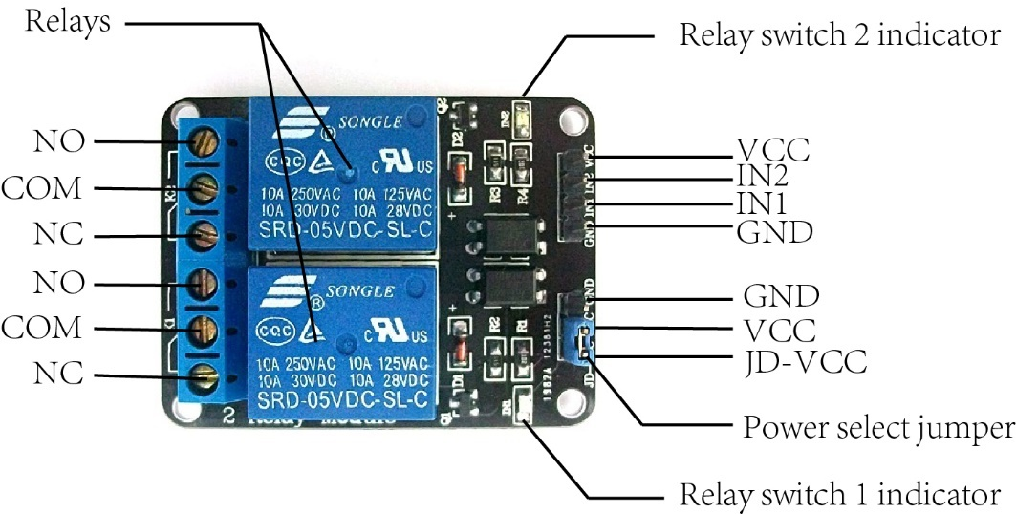
HARDWARE REQUIREMENTS
NodeMCU – 32-bit ESP8266 development board with Wi-Fi SoC.
2 – Channel Relay Module
Breadboard
Jumper Wires
Android Phone
Electrical Appliances
LED

Slide 7
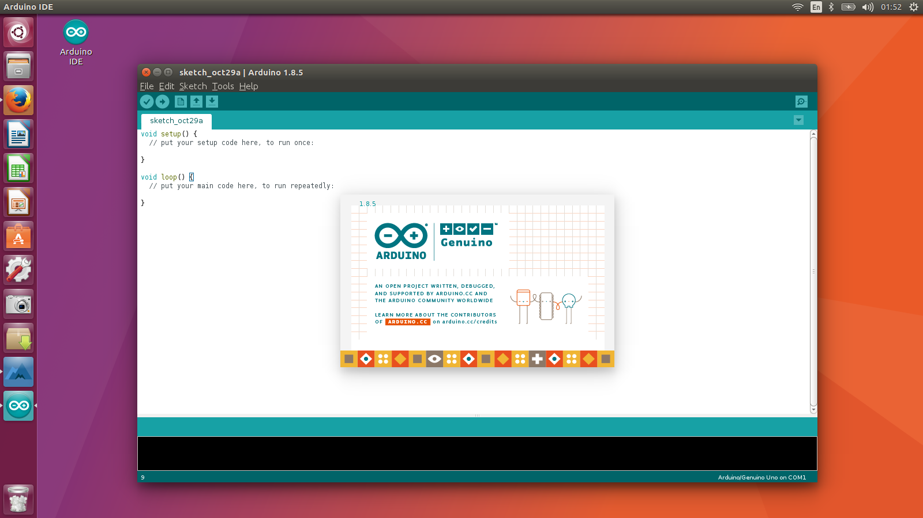
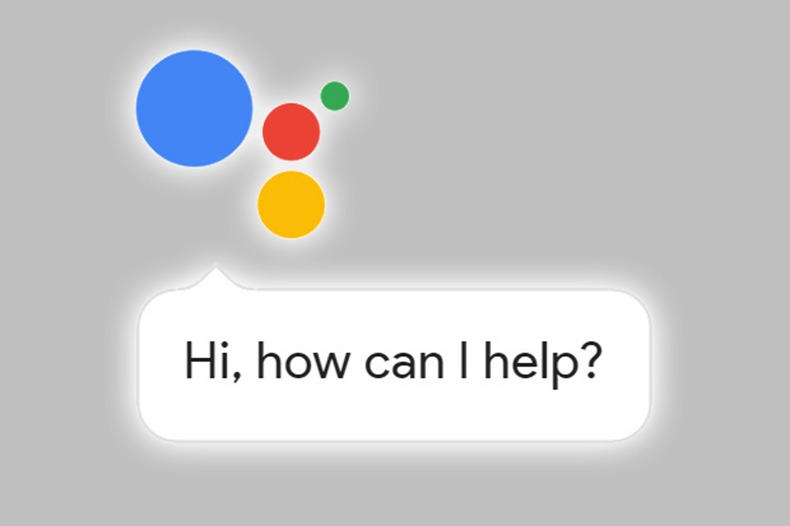

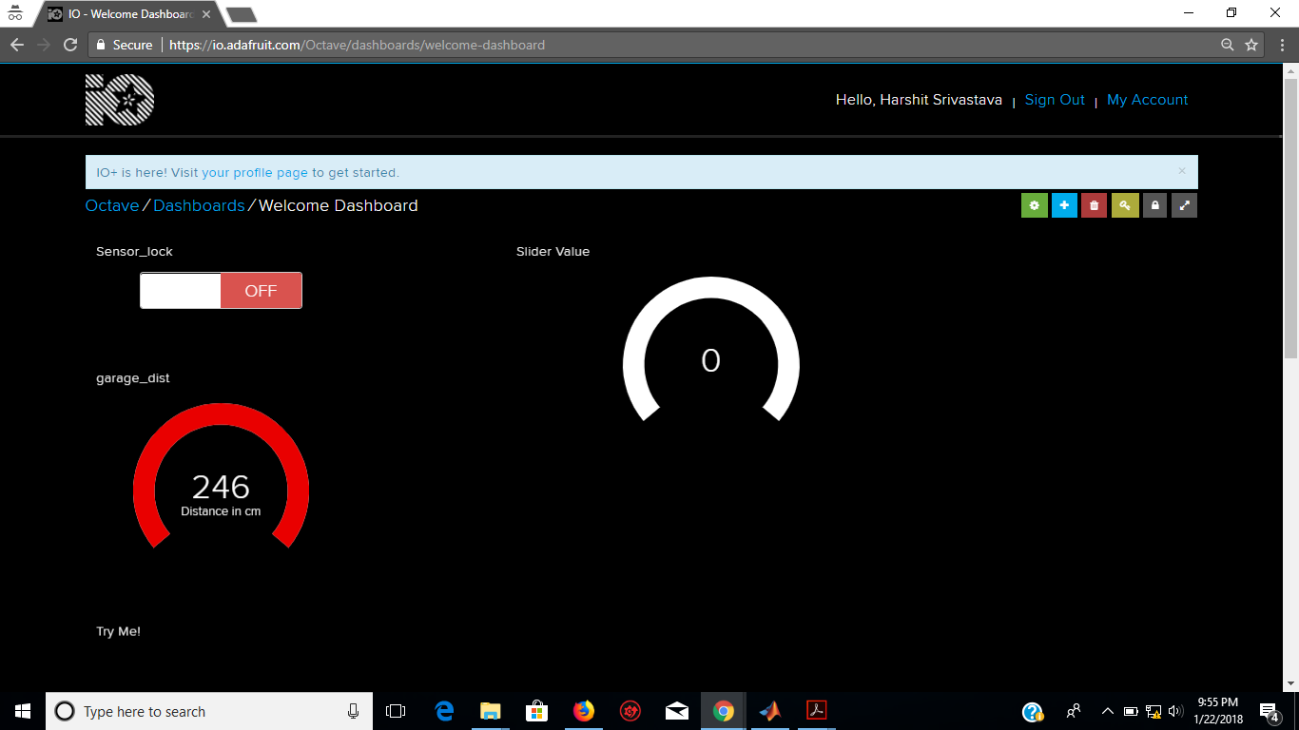
SOFTWARE REQUIREMENTS
Arduino IDE – 1.6.4
Google Assistant
IFTTT for android 4.0.2+
Adafruit MQTT

Slide 8
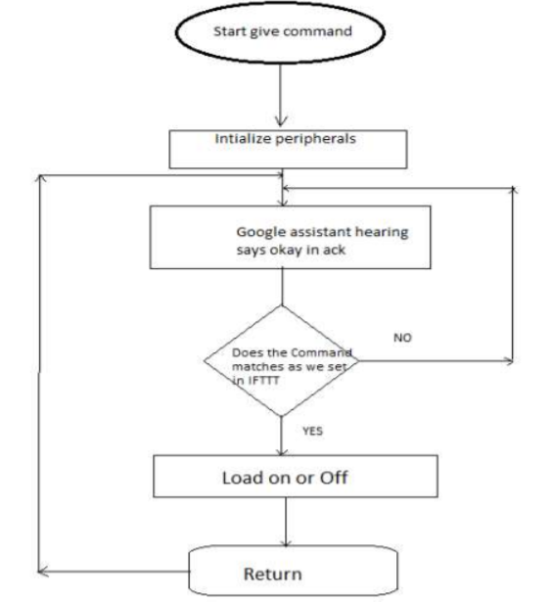
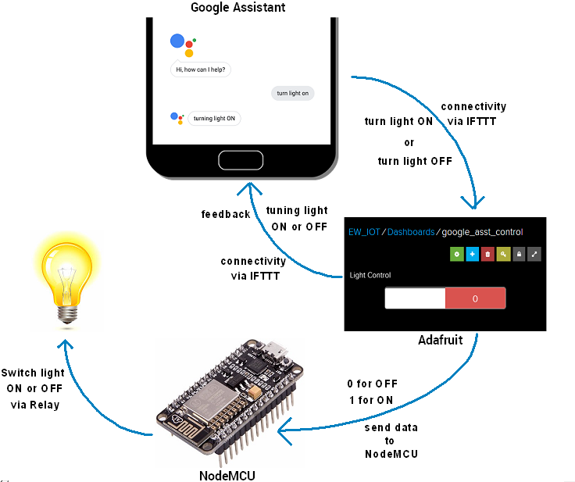
BLOCK DIAGRAM

Slide 9
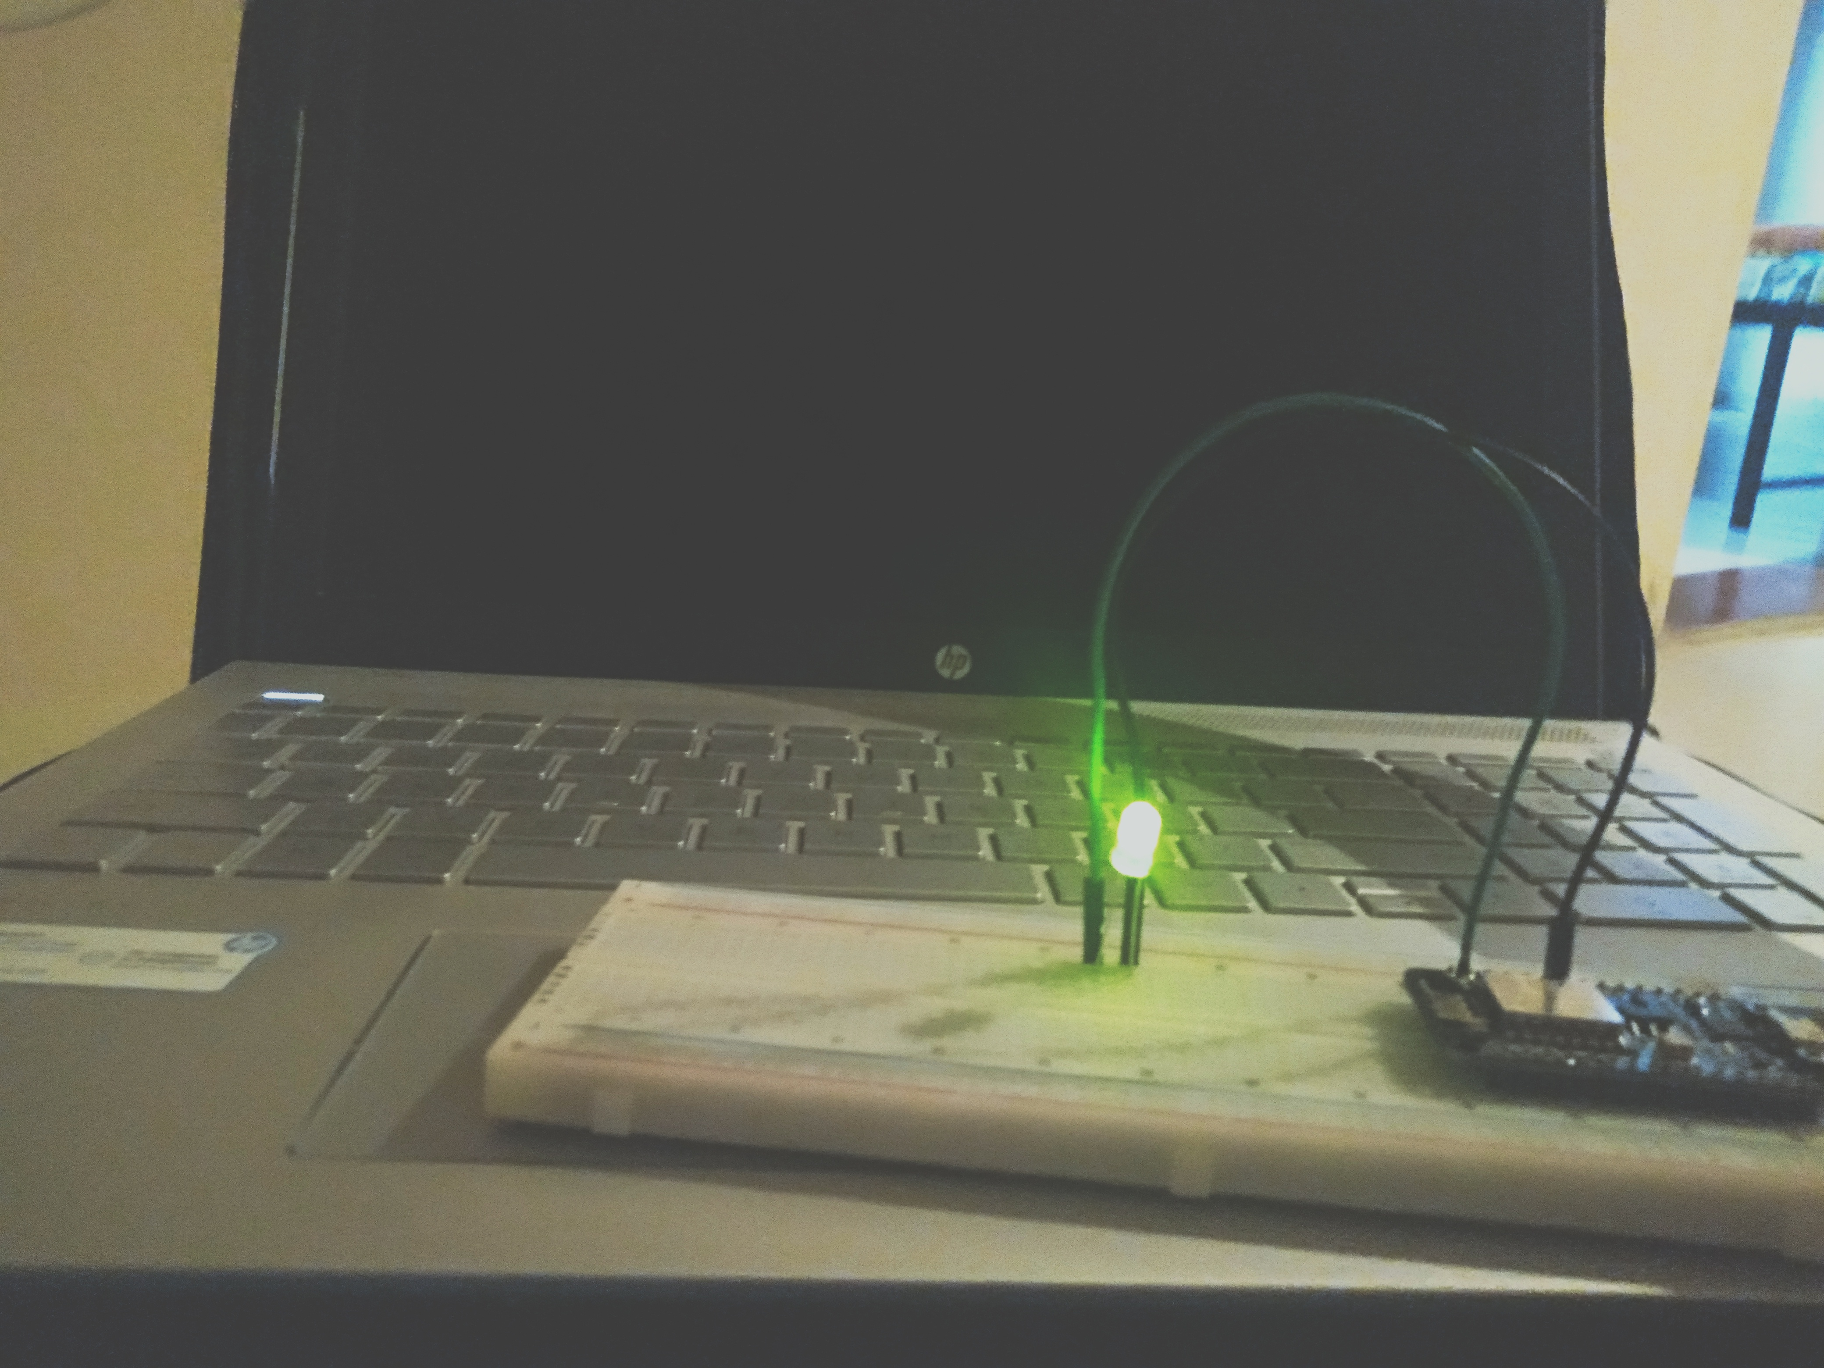
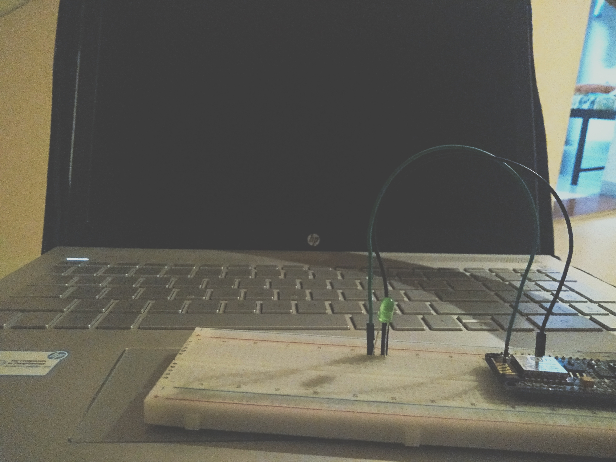
IMPLEMENTATION SCREENSHOTS

Slide 10
ROLES AND RESPONSIBILITIES OF EVERY PROJECT MEMBER
Following Team Members have worked effectively and have undertaken the below mentioned tasks:
Mansi Nakrani :- Handling and solving errors, Testing the application for vulnerabilities and bugs, PPT, Report.
Rutika Mehta :- Coding the logic, Creating a Design of flow, PPT, Report.
Varada Nair :- Researching in the related field of work, Making connections, PPT, Report.

Slide 11
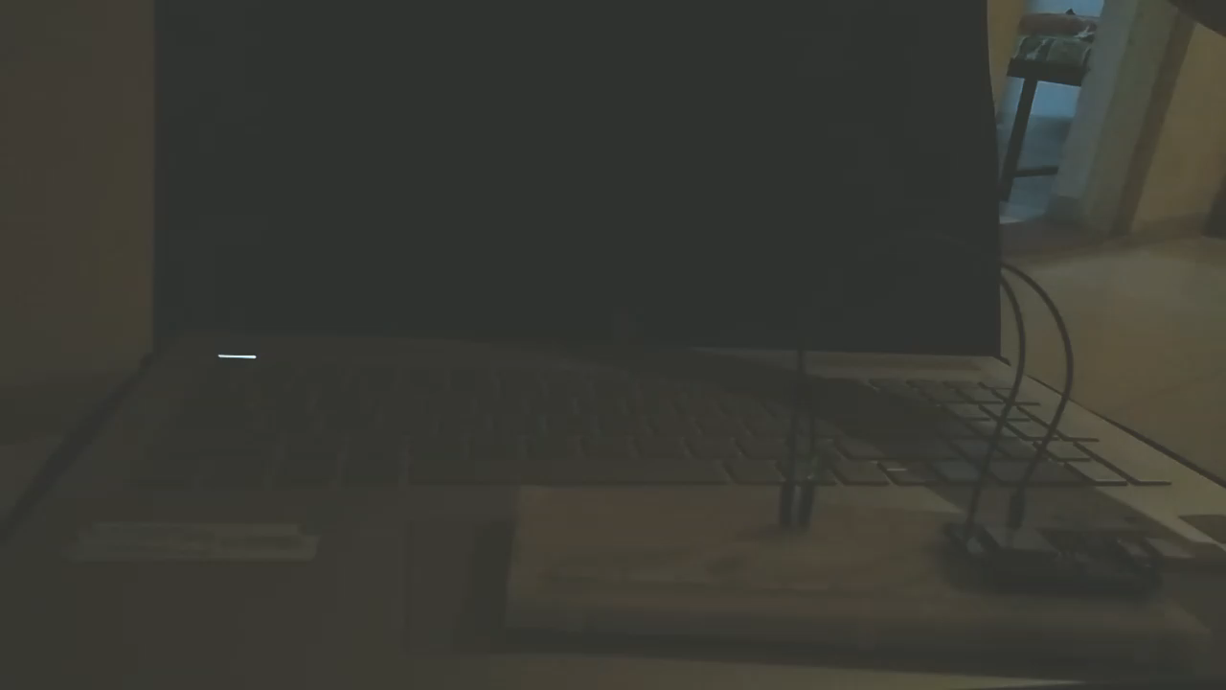
EXPECTED OUTCOME

Slide 12
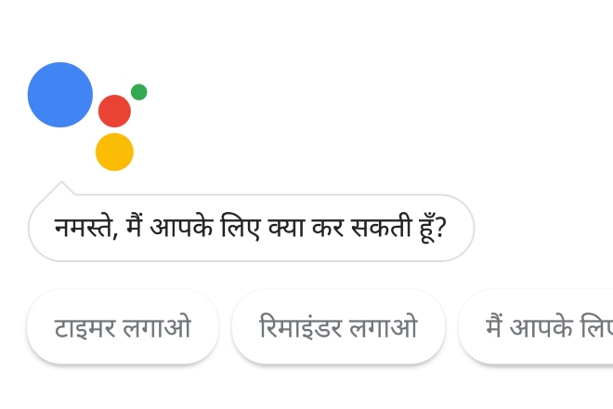
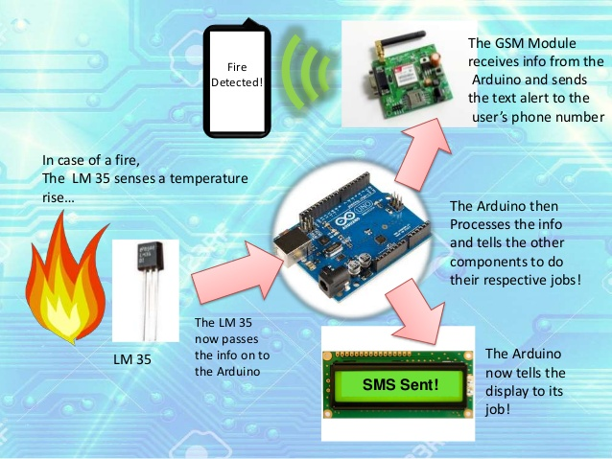
FUTURE SCOPE
More linguistic preferences will be offered
Alert messages
More secure system
Fire alarm system

Slide 13
REFERENCES
https://electronicsforu.com/electronics-projects/iot-home-automation-hindi-voice-commands-google
https://acadpubl.eu/hub/2018-119-12/articles/5/1303.pdf
https://www.instructables.com/id/Control-Your-Projects-With-Google-Assistant-and-Ad/
http://www.iosrjen.org/Papers/Conf.19014-2019/Volume-1/14.%2058-62.pdf
https://www.electronicwings.com/users/lokeshc/projects/control-home-appliances-using-google-assistant
https://www.electronics-lab.com/project/home-automation-using-nodemcu-esp8266-board/
https://www.ijarnd.com/manuscripts/v3i2/V3I2-1181.pdf

Slide 14
Thank You

